Slide 1
UML class diagrams

Slide 2
UML class diagrams
What is a UML class diagram?
class diagram: a picture of the classes in an OO system their fields and methods connections between the classes that interact or inherit from each other
What are some things that are not represented in a UML class diagram?
details of how the classes interact with each other algorithmic details; how a particular behavior is implemented

Slide 3
UML class diagrams
class name in top of box
use italics for an abstract class name attributes (optional)
should not include inherited method

Slide 4
Class attributes
attributes (fields, instance variables)
visibility name : type = default_value
visibility:
+ public
# protected
- private
/ derived
underline static attributes
attribute example: - balance : double = 0.00

Slide 5
Class operations / methods
operations / methods
visibility name ( parameters ) : return_ type
visibility:
+ public
# protected
- private
underline static methods
parameter types listed as (name: type )
omit return_type on constructors and when return type is void
method example: + distance(p1: Point, p2: Point): double

Slide 6
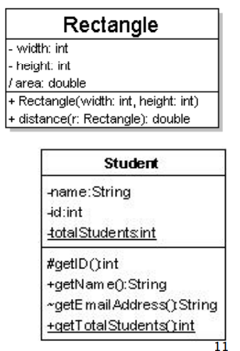
UML class diagrams

